Slide 1
We make car transport across Europe

Slide 2
Transhad since the beginning of its business activity has traded within the area of road transport of passenger cars, vans and minibuses. We transport new, luxury and second-hand vehicles.

Slide 3
Location
Transhad’s registered office is located in Dynów, a small town in south-eastern Poland, near Rzeszów.
This location is an advantage in terms of logistics – thanks to the closeness to the A4 motorway.

Slide 4
Historical background
We have gain our expertise in the domain of international transport provision unceasingly since 2009.
Our company was created thanks to the passion for motorization, logistics and transport.
www.transhad.com

Slide 5
We are an independent, private and rapidly growing company, specializing in transport of vehicles on car haulers. Our company is based on tractors of the following brands: Mercedes, Scania and Iveco which are equipped with the following trailers: Kässbohrer, Rolfo, Eurolohr and Rimo.

Slide 6
We adhere to the European standards referring to environment protection. All our vehicles meet the western standards EURO6 and EURO5.

Slide 7
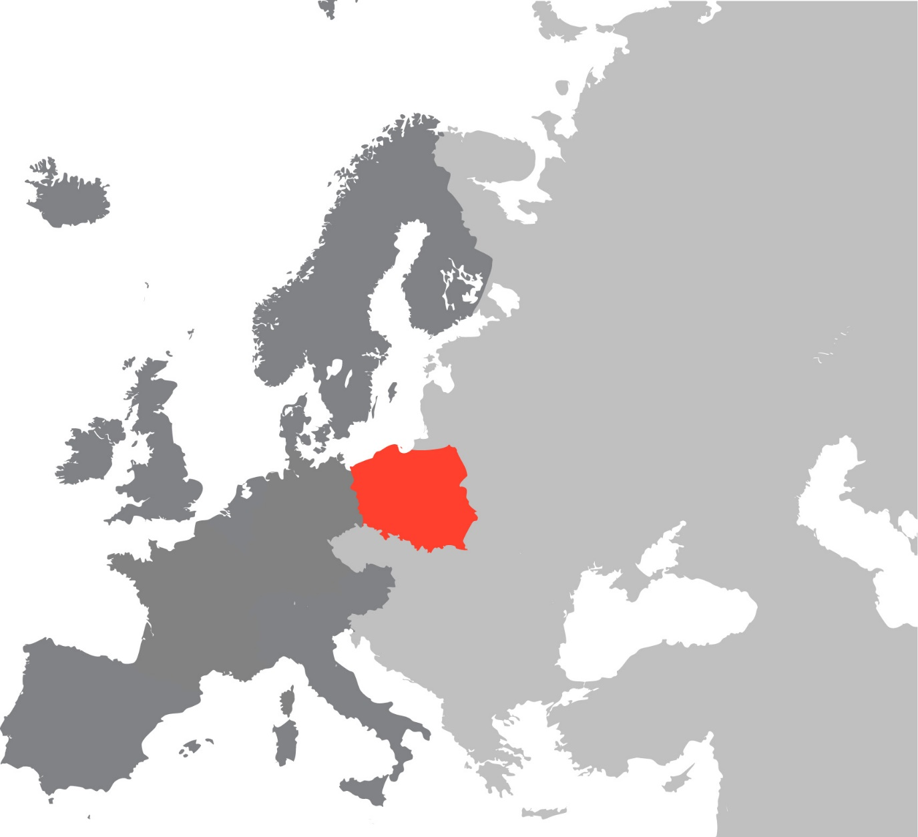
We provide transport services around the whole Western Europe.
Benelux
Germany
France
Italy
Spain

Slide 8
We cooperate closely with the European factories manufacturing vehicles, car dealers, distributors and with the renowned forwarding companies that expect transport of vehicles at the highest level.

Slide 9
Rolling stock
We are able to provide you with 17 car haulers together with a team of professionally trained employees. Our forwarders and drivers know probably everything about the transport and logistics. Thanks to the continuous investments in people and equipment we consecutively increase the level of services we provide.

Slide 10
Safety
We guarantee a quick, safe and punctual delivery of a cargo
Our vehicles are monitored by the GPS system, in collaboration with Juwentus company
Thus, the safety of our cargoes is ensured 24 hours 7 days a week
www.transhad.com

Slide 11
Our goal is to provide transport services at the highest level, and the customer satisfaction constitutes our greatest success!

Slide 12
By entrusting your cargo to our company you are certain that we will take care of:
Correctness of transport documents
Informing about the loading and unloading
Informing about all prospective obstacles during the transport (road conditions, etc.)
Parking a loaded vehicle only on attended car parks
Hourly control of a vehicle and cargo while being parked
Honesty – you are certain that the cargo will safely and timely reach its destination!

Slide 13
Why is it worth to establish a cooperation with our company?
We specialize in transport of vehicles on car hauls
The transport that is entrusted to us is safe at every stage of order completion
We guarantee an individual support and advising in the scope of the best transport organization
We offer competitive prices thanks to the direct service, without employment of subcontractors

Slide 14
The choice of Transhad guarantees:
• Timeliness of a delivery and cargo safety,
• Professional completion of a transport order,
• Service in Polish, English and German,
• A direct contact with the employees - above all, the drivers who are in charge of your ordered transport.
www.transhad.com

Slide 15
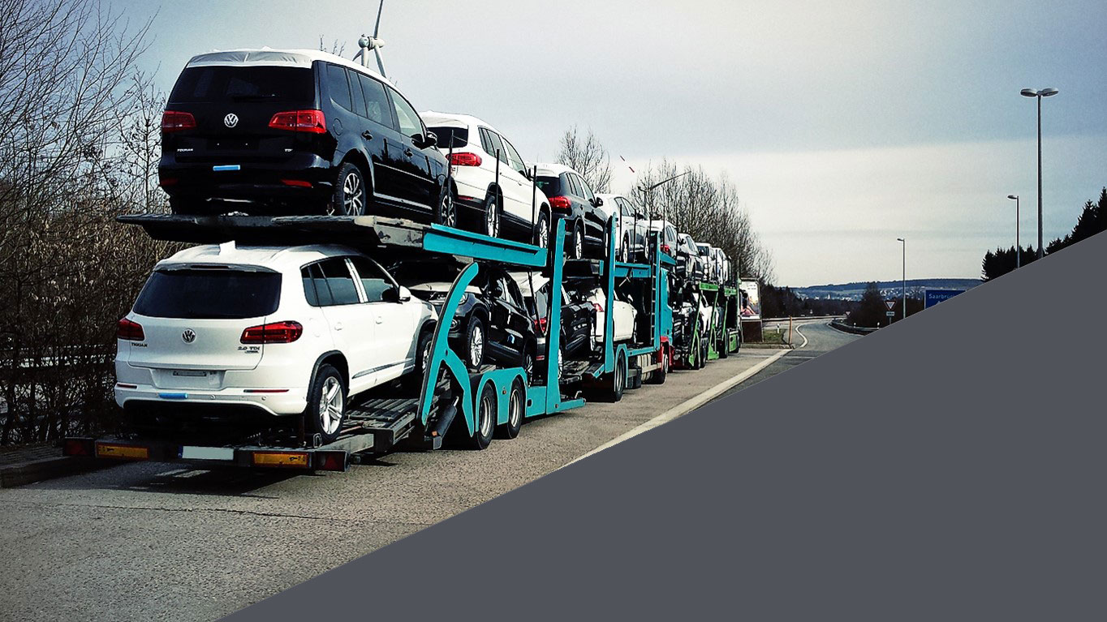
We are pleased to invite you to cooperation!
Damian Hadam
CEO
+48 662 519 910
www.transhad.com
office@transhad.com
correspondence adress:
ul. Kazimierza Wielkiego 2
36-065 Dynów
POLAND
Jarosław Sar
transport manager
+48 664 190 084

Slide 16
Thank you for your attention

